Slide 1
Big Data and Decision Making
DataSphere Analytics Presentation
By: Cristian Danci Junior Data Analyst
Notes:
Hi everyone, my name’s Cristian Danci, and I work as a Junior Data Analyst at DataSphere Analytics. Today I’ll be talking to you about how Big Data supports decision-making in modern organisations, what it means for end users, and the challenges data specialists face—especially when it comes to ethics and compliance.

Slide 2
My Role at DataSphere Analytics
Presenter Role: Junior Data Analyst at DataSphere Analytics
DataSphere Analytics specialises in data solutions including:
- Big Data Analytics
- Predictive Modelling
- Data Visualisation
We're presenting at the Data Innovation Summit 2025,
discussing how big data shapes future business intelligence.
Notes:
In my role at DataSphere, I help support clients by working on projects involving big data analysis, visualisation, and predictive modelling. We’ve been invited to the Data Innovation Summit 2025 to share our insights into how big data is shaping the future of business intelligence, and this presentation reflects our contribution to that summit.

Slide 3
Introduction
Analyzing of Big Data for DataSphere represents the enormous quantities of organized and disorganized data produced very quickly. Big Data is important for DataSphere because businesses and organizations use it to discover insights and guide their decision-making processes. Experts define Big Data complexities by breaking down its essential attributes into six fundamental characteristics called the Six V’s of Big Data. The six V’s of Big Data—Volume, Variety, Velocity, Veracity, Value, and Variability—provide understanding of the scale and diversity along with the challenges involved in managing vast datasets.
Notes:
Big Data refers to huge amounts of information that come in quickly and in different forms—far beyond what traditional tools can handle. At DataSphere, we use it to spot trends, make decisions, and help our clients gain competitive advantages. To understand Big Data better, it’s useful to look at the 6 Vs, which break down its main features and challenges.

Slide 4
The Big 6 V’s of Big Data explain why big data possesses both immense power and complexity. Volume represents the enormous quantities of data produced every second including social media updates and sensor readings. Velocity represents how fast we create, gather and process data streams which frequently operate in real-time environments. Variety represents the multiple forms of data including structured data such as spreadsheets as well as semi-structured data like XML files and unstructured data such as videos and emails. Veracity examines data trustworthiness and quality because poor data quality leads to poor decision-making. Value reflects how actionable information derived from data supports users and organizations. Variability describes data flow inconsistencies which result from unpredictable spikes in data loads that complicate management efforts. The combination of these six V’s reveals both potential benefits and difficulties associated with big data projects.
The Big 6 V’s of Big Data
Notes:
Let’s break down the 6 Vs: - Volume is the massive amount of data generated daily. - Velocity is how fast it arrives—often in real time. - Variety refers to the many formats, like video, text, or spreadsheets. - Veracity is about data accuracy and trustworthiness. - Value is the insight we get from it. - And Variability covers inconsistencies in data flow. These six together help us understand both the potential and the complexity of Big Data.

Slide 5
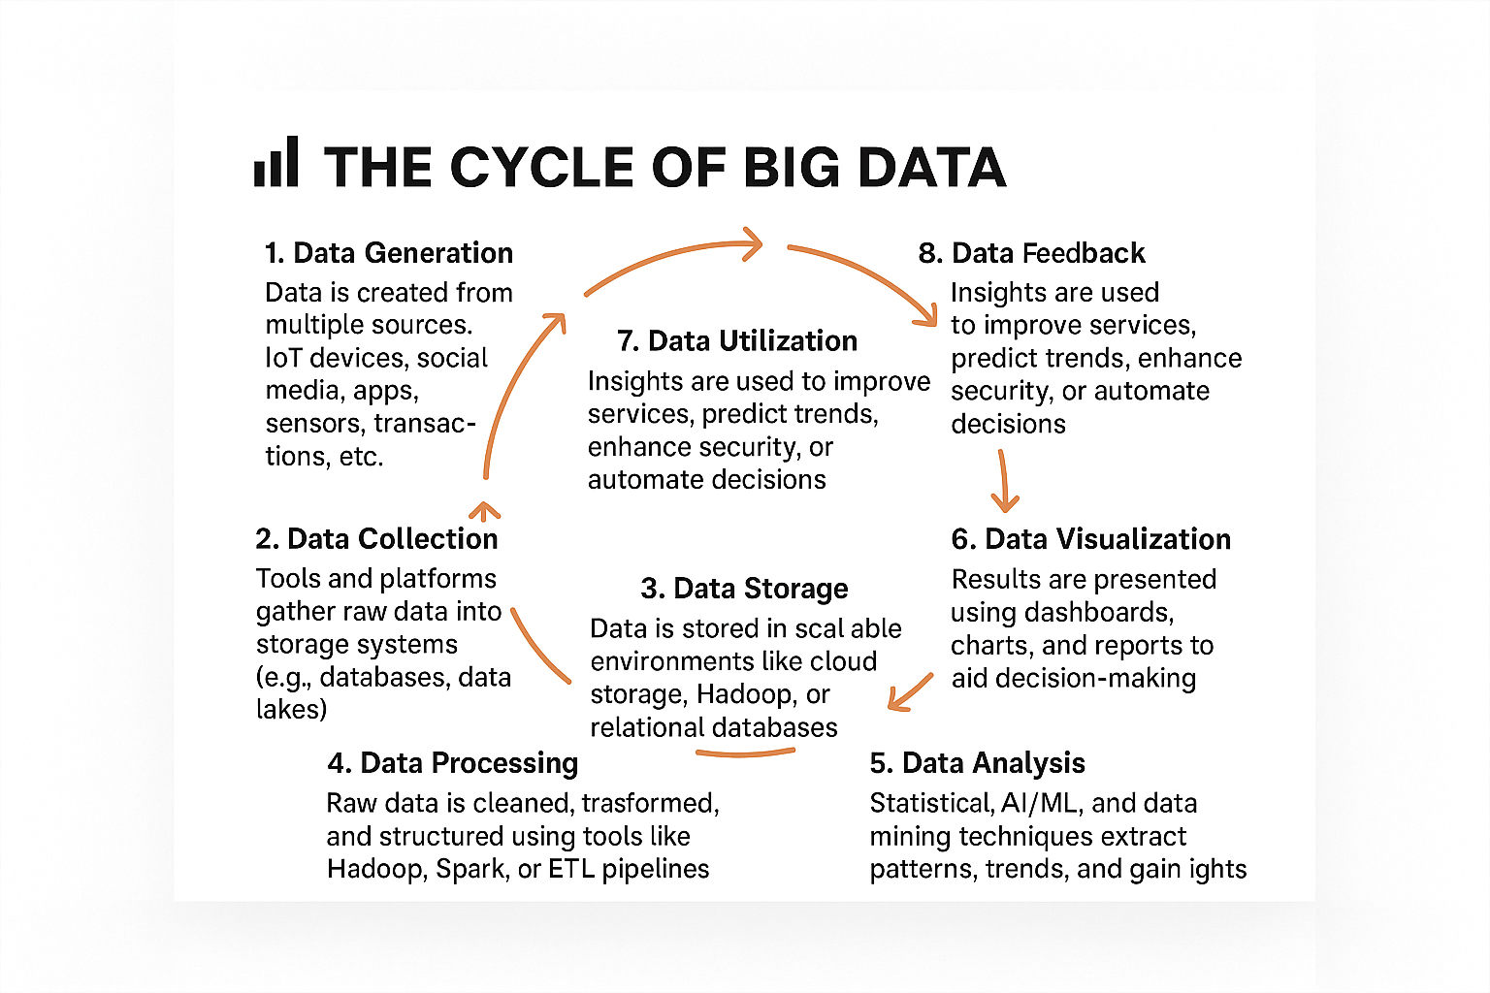
Notes:
The Big Data lifecycle explains how data flows from creation to action. It includes eight key stages:
Generation – Data is created by users, devices, or systems like sensors and applications.
2. Collection – That data is then captured through platforms, apps, or software tools.
3. Storage – It’s securely stored in databases or cloud environments, ready for use.
4.Processing – We clean, organize, and structure the data to prepare it for analysis.
5. Analysis –Tools like AI and statistical methods are applied to extract insights.
6. Visualization – Theseinsights are presented using dashboards, graphs, or charts.
7. Utilization – The data is used to guide decisions, improve services, or drive innovation.
8. Feedback – Outcomes from decisions generate new data, feeding the cycle again. Each stage must be handled responsibly to ensure compliance, accuracy, and value.
Understanding this lifecycle helps us unlock the full power of BigData.This is the Cycle of Big Data, the process data goes through from creation to action:

Slide 6
The Importance of Data for Decision Making
1. Informed Decisions
Data removes guesswork.
This process enables teams and leaders to opt for evidence-based decisions over conjectural ones.
2. Performance Monitoring
Helps track progress against goals (e.g., KPIs).
Reveals what strategies are working or failing.
3. Identifying Trends and Patterns
Data uncovers hidden insights and behavioral patterns.
Organizations using data for their operations can quickly adjust to changing market situations.
7. Innovation and Growth
Organizations can test new ideas by analyzing authentic feedback from their users.
Leads to continuous improvement and innovation.
Notes:
Organizations don’t want to guess—they want evidence. Data helps leaders make informed choices, track performance, and see patterns in customer behaviour. It also opens the door for innovation, because real feedback lets companies improve continuously. But at the same time, this means we must also be responsible with how we use people’s data.

Slide 7
Personalized User Experience: E-commerce and streaming platforms customize recommendation systems for their users. Informed Consumer Choices: The combination of reviews with price comparisons and analytics enables buyers to make better purchasing decisions. Improved Convenience: AI-powered assistants and automation optimize daily activities. Privacy Concerns: Users need to understand what happens to their personal data during collection, storage, and utilization processes.
End Users Experience the Effects of Data-Driven Decision-Making Processes
Notes:
For users, data-driven decision-making shows up in lots of ways—like Netflix recommending shows or online stores personalising what we see. But there are downsides too, especially around privacy. As analysts, it’s our job to think not just about performance, but about fairness and transparency for users.

Slide 8
The Impact of Data-Driven Decision-Making on Organizations and End Users
Analyzing Benefits, Challenges, and Strategic Implications
Introduction to Data-Driven Decision-Making
Definition: Data-driven decision-making (DDDM) uses data analysis results to direct organizational strategies and operational activities. Relevance: Both organizations and end users experience enhanced efficiency and accuracy together with better strategic foresight through data-driven decision-making. Purpose of Presentation: This presentation aims to explore how data utilization affects decision-making by identifying benefits and challenges as well as its overall impact.
Advantages of Data-Driven Decision-Making for Organizations Improved Accuracy: Data-driven business decisions occur because data removes uncertainty from decision-making processes. Operational Efficiency: Automation and AI-driven insights streamline workflows. Enhanced Customer Experience: Personalized recommendations and targeted marketing. Competitive Advantage: Organizations that utilize big data obtain valuable market trend information. Risk Mitigation: Predictive analytics enhances fraud detection systems and cybersecurity protocols.
A research I used for DDDM (Dana Lagzi,, et al., 2025)
Notes:
DDDM helps companies plan better, reduce risks, and stay competitive. But it’s not perfect—data overload, privacy laws like GDPR, and the cost of implementation all create challenges. The key is to find a balance between innovation and user protection. That’s something we focus on heavily at DataSphere. A research I used for DDDM (Dana Lagzi,, et al., 2025)

Slide 9
Challenges of Data-Driven Decision-Making for Organizations Data Overload: Analysis becomes complex and time-consuming when there is too much data. Data Privacy and Compliance: Compliance with regulations like GDPR is essential for organizations. Integration Issues: Organizations need to ensure their systems work together flawlessly to merge data from several different sources. High Implementation Costs: Advanced analytics tools and AI models demand substantial financial resources. Human Resistance: Workers show resistance towards data-based decision-making because they worry their positions will be automated.
The Impact of Data-Driven Decision-Making on Organizations
Market Insights: Through data analytics businesses acquire knowledge about customer habits and industry trends.
Enhanced Strategic Planning: Business growth over the long term and decision-making processes benefit from the use of forecasting tools.
Real-Time Decision-Making: Live data analysis enables organizations to make rapid responses to changes in market conditions.
Data Security Risks: Companies need to protect sensitive information belonging to both customers and themselves against unauthorized access.
Notes:
Google and Walmart are great examples. Google uses data to improve search results, personalise YouTube, and help businesses advertise smarter. Walmart uses it for inventory, pricing, and logistics. They show that when used well, data really does power better decisions.

Slide 10
Google and Walmart both leverage data to drive their decision-making processes.
Google: Search Algorithms: Google combines data analytics and machine learning to improve both search accuracy and user experience. Advertising (Google Ads): Businesses use targeted advertisement strategies based on data collected from user browsing history and engagement patterns. Cloud Services & AI: Through its cloud services Google collects business data to enable artificial intelligence-driven insights and optimization. YouTube Personalization: The YouTube personalization system uses user behavior data to make content suggestions.
Walmart: Inventory Management: Walmart utilizes real-time sales data to efficiently forecast demand and manage restocking operations. Customer Insights: Walmart optimizes pricing strategies and product placement through analysis of customer shopping behavior. Supply Chain Optimization: Supplier coordination and logistics planning experience improvements through big data analytics. Checkout & Payment Solutions: The retail experience improves through AI-enhanced self-checkout systems and fraud detection mechanisms.
Notes:
This isn’t just about tech companies. Big data is transforming every industry—like Amazon in retail, AI diagnostics in healthcare, fraud detection in banking, and real-time tracking in logistics. It’s everywhere, and it’s changing how decisions get made from the ground up.
“Two companies that use DDDM effectively are:
Google:
Uses data to refine search and personalize ads.
Recommends YouTube content using user behavior.
Walmart:
Tracks real-time sales for inventory control.
Analyzes shopping patterns to improve layout and product placement.
Uses AI for faster checkouts and fraud detection.
These companies show how DDDM drives efficiency and user satisfaction.
To compare with other leaders:
Google uses analytics to improve search, ads, and video recommendations.
Walmart uses real-time data to manage inventory and logistics. At DataSphere, we follow similar principles — using data to optimize decision making across departments.

Slide 11
Data Utilization at the Management Level
Performance Monitoring: Key Performance Indicators (KPIs) help businesses evaluate their progression.
Predictive Analytics: Anticipating future trends aids proactive decision-making.
Prescriptive Analytics: Data-driven recommendations optimize decision outcomes.
Risk Assessment: Data helps management detect potential threats and take appropriate mitigation actions.
Conclusion
Organizations achieve greater efficiency and accuracy in strategic planning through data-driven decision-making.
Organizations gain market advantages through data usage even while facing difficulties.
Improved services benefit users while they need to stay aware of privacy issues.
The implementation of ethical data practices alongside proper governance leads to sustainable success.
Real-World Examples of Data-Driven Decision-Making
Retail: Amazon’s recommendation engine enhances customer experience.
Healthcare: Advanced diagnostic systems driven by artificial intelligence together with patient data work to enhance treatment approaches.
Finance: Banks deploy fraud detection systems to find suspicious activities.
Logistics: The implementation of real-time tracking systems enables supply chain management improvements and better delivery route planning.
The Six V’s framework offers a complete approach to grasp both the challenges and opportunities in processing vast amounts of data. Businesses that master these characteristics can apply data to inform strategic planning while driving innovation and improving customer interactions. Businesses need to allocate resources towards advanced analytics, cloud computing and artificial intelligence to maintain competitive advantage in the rapidly changing data-driven environment.
Notes:
Management uses data to monitor progress through KPIs, forecast trends with predictive analytics, and even get recommendations for what to do next using prescriptive models. It also helps with risk management—spotting issues early. This kind of insight makes a huge difference at strategic levels.

Slide 12
Roles of Data Specialists
Key Data Specialist Roles:
- Data Engineer: Builds infrastructure, ensures ethical sourcing, scalability
- Data Scientist: Creates models, reduces algorithmic bias
- Data Governance Officer: Enforces policy, ensures ethical compliance
Notes:
There are three key roles I’ll mention here: - Data Engineers build the data infrastructure. -Data Scientists analyse the data and build models. - And Data Governance Officers make sure we follow ethical and legal standards. They all work together to keep data powerful but responsible.

Slide 13
Challenges of Data Specialists:
1. Data Engineer –
Managing Data Volume and Velocity: Real-time data streams and big datasets strain pipelines and storage solutions.
Ensuring Ethical Data Sourcing: Identifying and excluding biased or illegally sourced data is increasingly critical.
Balancing Scalability with Cost: Designing scalable architectures without overspending on cloud or infrastructure.
Tool Integration: Managing compatibility across multiple data tools, platforms, and formats.
Data Scientist-
Reducing Algorithmic Bias: Training models without unintentionally reinforcing societal or historical biases.
Model Interpretability vs. Accuracy: Balancing complex models' performance with the need for explainability.
Data Quality Issues: Incomplete, noisy, or biased data can lead to unreliable predictions.
Rapidly Evolving Tools: Keeping up with the constant innovation in AI/ML frameworks.
3. Data Governance Officer –
Enforcing Compliance Across Departments: Ensuring consistent policy adherence in a decentralized data environment.
Keeping Up with Regulations: Adapting quickly to global changes in data privacy laws (e.g., GDPR, CCPA).
Data Ownership & Stewardship: Defining and assigning accountability for data assets organization-wide.
Balancing Accessibility with Control: Making data available to analysts without compromising security or ethics.
Notes:
Next we will examine the main obstacles encountered by various data specialist roles in the industry. 1. Starting with the Data Engineer: These professionals build and maintain infrastructure for data systems. Data Engineers face major difficulties handling massive amounts of quick data movement which could easily overwhelm pipelines without proper scaling. Data sets must be obtained through legal and fair processes to meet ethical sourcing standards. Cost is another pressure point. Building scalable systems requires skill but creating them within budget constraints presents an entirely different challenge. The integration of an expanding suite of data tools and platforms creates significant technical difficulties. 2. Next, the Data Scientist:
Data Scientists dedicate their efforts to constructing models that harness valuable insights from data sets.
A crucial task for Data Scientists is to ensure their models remain unbiased and do not perpetuate unfair trends.
The use of complex models to improve accuracy presents a dilemma for data scientists because these same models become difficult for stakeholders to understand.
The effectiveness of data science models depends directly on the quality of data they process which tends to be disorderly and incomplete.
The rapid evolution of machine learning makes it difficult to maintain current knowledge about available tools.
3. Finally, the Data Governance Officer:
The Data Governance Officer role centers around maintaining data policy enforcement and adherence to legal and regulatory requirements.
Different teams and departments present obstacles to maintaining uniform standards across the organization.
Keeping up with the ever-changing legal requirements including GDPR and various privacy regulations remains essential for them.
The identification of data ownership and management responsibilities remains ambiguous within corporate structures.
And perhaps the biggest challenge is balancing two opposing needs: Organizations must enable teams to access essential data without risking its misuse through appropriate safeguards.
[Pause briefly]
The interconnected nature and complexity of big data demonstrate why collaboration between different roles within an organization remains crucial.

Slide 14
Challenges and Compliance
Challenges & Compliance Strategies:
- Managing algorithmic bias and dynamic legal frameworks
- Strategies: Ethical audits, Explainable AI, Stakeholder consultation
- Legal examples: GDPR (EU), Data Protection Act (UK)
- Importance: Build user trust, reduce risk, support ethical innovation
Notes:
Some of the biggest challenges are bias in algorithms, keeping up with changing regulations, and handling data across countries. To deal with these, we use strategies like ethical audits, explainable AI, and regular stakeholder reviews. Laws like GDPR help keep us accountable too.

Slide 15
Ethics and Responsibility
Building Ethics into a Data-Driven Culture:
- Ethics in big data: Privacy, fairness, transparency
- Integration strategies: Ethics training, transparent AI, internal reviews
- Data specialists ensure data is used fairly & responsibly
- Challenges: Cross-border data, evolving laws, organisational pressure
Notes:
Ethics is a big topic in big data. We need to make sure that systems are fair, that users know how their data’s used, and that decisions aren’t discriminatory. That means training teams, building transparency into our tools, and constantly reviewing how data is handled. It’s not easy, but it’svital.

Slide 16
Conclusion
Navigating today's fast-paced world requires more than gut feelings due to its inherent complexity. Organizations and individuals can make more intelligent decisions by using data-driven decision making which replaces assumptions with real evidence. By employing big data we gain transparent understanding whether we manipulate massive datasets or observe patterns over time.
Through the 5 Vs framework which includes volume, velocity, variety, veracity and value we can turn complex data into dependable insights which drive both action and learning. Data utilization produces high-quality decisions which support team members and individuals while creating a better tomorrow.
Notes:
To sum up: Big Data is an incredible tool—but only if we use it wisely. When we match innovation with accountability and ethics, we create decisions that benefit everyone—from users to organisations. That’s what we aim for at DataSphere.

Slide 17
Thank you
Cristian Danci
G235006
Notes:
Thanks for listening! I’d be happy to take any questions and hear your thoughts on how we can use data even more responsibly and effectively. Thank you for your time. I hope this has given you a clear view of how Big Data and Data-Driven Decision Making work in practice. I’m happy to answer any questions.

Slide 18
References
Dana Lagzi,, M., Farkhondeh, F., Amoozad Mahdiraji, . H. & Sakka, G., 2025. Research output. [Online]
Available at: https://research.birmingham.ac.uk/en/publications/exploring-data-driven-decision-making-practices-a-comprehensive-r#:~:text=Findings%3A%20The%20review%20identifies%20machine%20learning%2C%20statistical%20models,simulation%20emerge%20as%20promising%20avenu
Laney, D. (2001). 3D Data Management: Controlling Data Volume, Velocity, and Variety. META Group. – Introduced the original “3 Vs” concept, foundational to understanding big data.
Gandomi, A., & Haider, M. (2015). Beyond the Hype: Big Data Concepts, Methods, and Analytics. International Journal of Information Management, 35(2), 137–144. – A deep dive into the challenges and tools of big data.
McAfee, A., & Brynjolfsson, E. (2012). Big Data: The Management Revolution. Harvard Business Review. – Discusses how data transforms how businesses make decisions.
Chen, H., Chiang, R. H. L., & Storey, V. C. (2012). Business Intelligence and Analytics: From Big Data to Big Impact. MIS Quarterly, 36(4), 1165–1188. – Explores the impact of data analytics on decision-making.
Davenport, T. H., & Harris, J. G. (2007). Competing on Analytics: The New Science of Winning. Harvard Business Review Press. – A classic on how organizations gain advantage through analytics.
Mayer-Schönberger, V., & Cukier, K. (2013). Big Data: A Revolution That Will Transform How We Live, Work, and Think. Houghton Mifflin Harcourt. – Examines how big data reshapes society and business.
Provost, F., & Fawcett, T. (2013). Data Science for Business. O’Reilly Media. – A practical guide for understanding how data science fits into business decisions.
Schmarzo, B. (2013). Big Data: Understanding How Data Powers Big Business. Wiley. – Focuses on monetizing big data and turning insights into value.
Notes:
These references support the information in this presentation for Datasphere — covering Big Data theory, analytics practice, real-world case studies, and the ethical and legal side of data use.
These are the references that shaped our thinking at DataSphere, covering the theory and real-world applications of big data and decision making.
Continue LO1 part in guidelines then add LO4 to slides also in text citations to each slide. Fix Layout for Slides so readers can see.

